Slide 1
Research Methods in Computing and Technology CT098-3-2
Sampling

Slide 2
Topic & Structure of the lesson
Understanding sampling
Probability sampling vs. non-probability sampling

Slide 3
Learning Outcomes
At the end of this topic, you should be able to:
Decide which sampling method to adopt
Select a sample of subjects / participants for the research that will be done

Slide 4
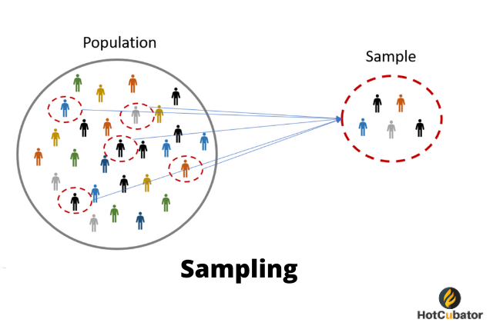
Sampling
Obtaining information from a portion of a larger group / population to draw conclusions about the entire population

Slide 5
Why sample?
When we choose certain items out of the whole population to analyze the data and draw a conclusion thereon, it is called sampling.
The population of interest is usually too large to attempt to survey all of its population.
A carefully chosen sample can be used to represent the population.
The sample reflects the characteristics of the population from which it is drawn.

Slide 6
Reasons for sampling
Lower cost
Greater accuracy of results
possibility of better testing
More thorough investigation of missing, wrong or suspicious information
Greater speed of data collection – reduces time between recognition of a need for information and availability of that information
Availability of population elements – crash test cars for air bags testing

Slide 7
Sampling Methods
SAMPLING
PROBABILITY
NON-PROBABILITY
Notes:
The first is known as probability sampling, the second as non-probability.
Probability sampling, as the name suggests, is based on the idea that the people or events that are chosen as the sample because the researcher has some notion of the probability that these will be representative cross-section of the people or events in the whole population being studied. On the other hand non-probability sampling is conducted without such knowledge about whether those included in the sample are representative of the overall population.

Slide 8
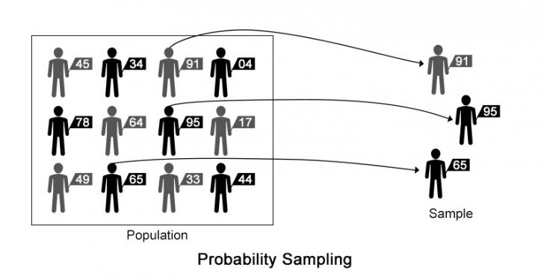
Probability Sampling
Random selection (selecting at random by number)
A controlled procedure that assures that each population element is given a known non-zero chance (equal probability) of selection

Slide 9

Non-Probability Sampling
A non-probability sample is one in which a case in a sample is chosen in such a manner that it gives you information for the sample itself and makes it possible to generalize the findings for the population with certain degree of precision.
Such a sample is also called a purposive sample. This kind of sampling is primarily used to collect information on market surveys to know the attitude, opinion, behaviour, reactions of individuals.
There are many types of non-probability samples, including snowball sampling, convenience, purposive/ judgment, quota sampling, etc.

Slide 10
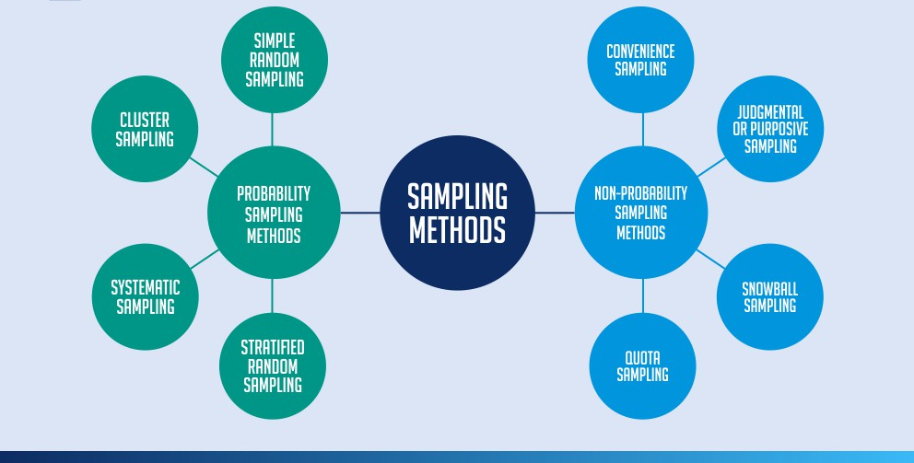
Sampling Methods
Notes:
The first is known as probability sampling, the second as non-probability.
Probability sampling, as the name suggests, is based on the idea that the people or events that are chosen as the sample because the researcher has some notion of the probability that these will be representative cross-section of the people or events in the whole population being studied. On the other hand non-probability sampling is conducted without such knowledge about whether those included in the sample are representative of the overall population.

Slide 11
Simple Random Sampling
Complex Probability Sampling
Probability Sampling
Systematic Sampling
Stratified Sampling
Cluster Sampling
Notes:
Cluster sampling - Assuming a fixed sample size, the technique gives more accurate results when most of the variation in the population is within the groups, not between them.

Slide 12
Simple Random Sampling
Each population has a known and equal chance of selection
Probability of selection = sample size / population size
Aid of computer software, table of random numbers, calculator with random generated numbers, drawing slip out of a hat / bag

Slide 13
Simple Random Sampling
An example of a simple random sample would be the names of 25 employees being chosen out of a hat from a company of 250 employees. In this case, the population is all 250 employees, and the sample is random because each employee has an equal chance of being chosen.

Slide 14
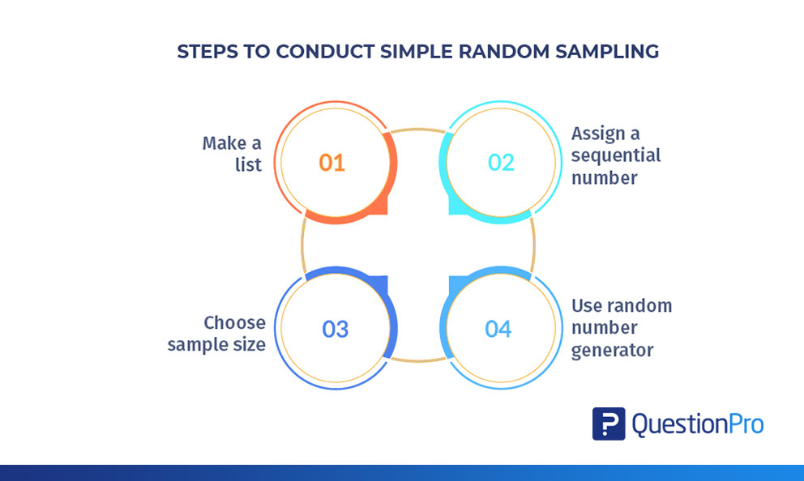
Simple Random Sampling

Slide 15
Simple Random Sampling
Not practical
Need a list (sampling frame) – not available
Fails to use all information about population
Expensive
Time consuming

Slide 16
Complex Probability Sampling
Systematic Sampling
Every k^{th} element in the population sampled
k = skip interval = population / sample
Random start
Stratified Sampling
Segregating the population into several mutually exclusive sub populations / strata
Cluster Sampling
Dividing the population into groups of elements with some groups randomly selected for study
Notes:
Stratified sampling – divide into non overlapping groups – eg geographical location, age group, gender
Cluster sampling - Assuming a fixed sample size, the technique gives more accurate results when most of the variation in the population is within the groups, not between them.

Slide 17
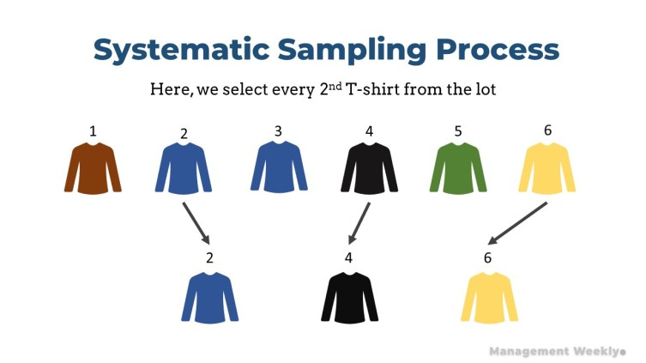
Complex Probability Sampling
Notes:
Stratified sampling – divide into non overlapping groups – eg geographical location, age group, gender
Cluster sampling - Assuming a fixed sample size, the technique gives more accurate results when most of the variation in the population is within the groups, not between them.

Slide 18
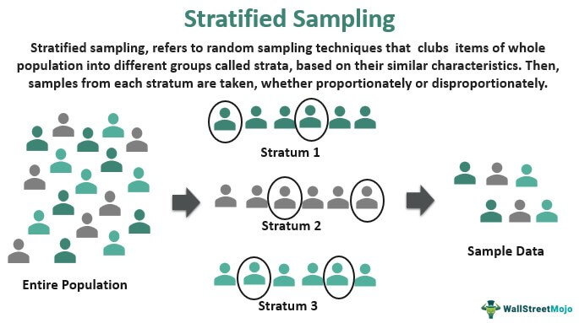
Complex Probability Sampling
Notes:
Stratified sampling – divide into non overlapping groups – eg geographical location, age group, gender
Cluster sampling - Assuming a fixed sample size, the technique gives more accurate results when most of the variation in the population is within the groups, not between them.

Slide 19
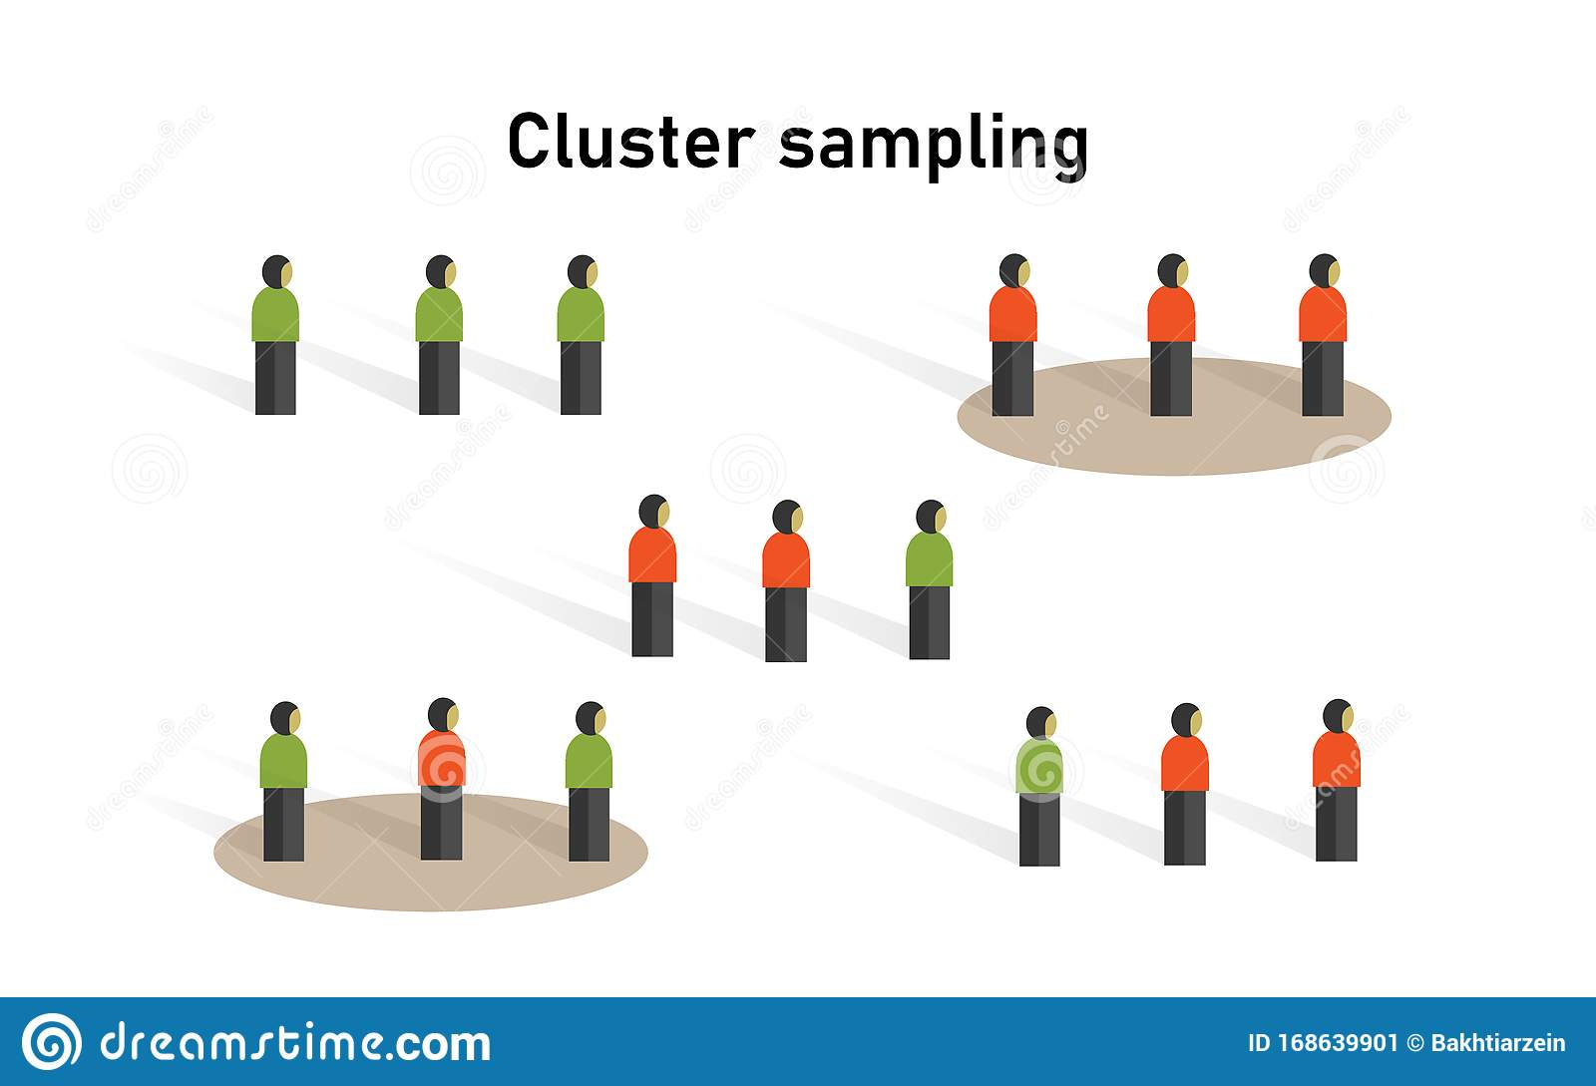
Complex Probability Sampling
Notes:
Stratified sampling – divide into non overlapping groups – eg geographical location, age group, gender
Cluster sampling - Assuming a fixed sample size, the technique gives more accurate results when most of the variation in the population is within the groups, not between them.

Slide 20
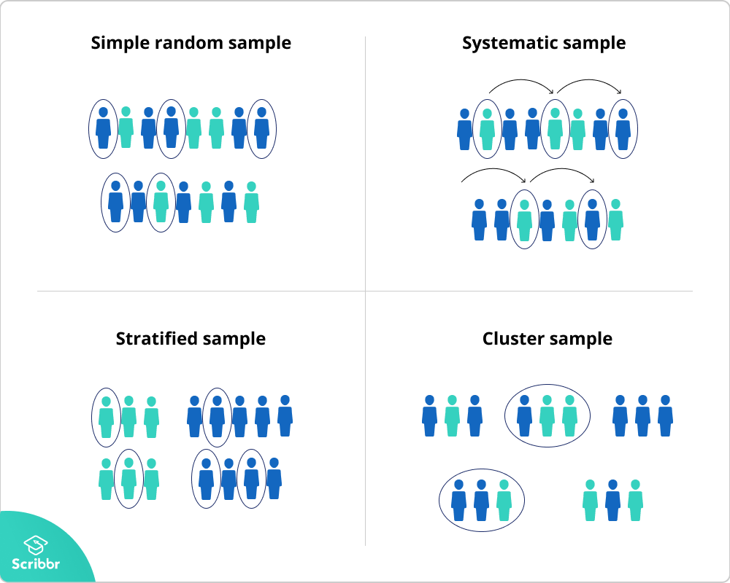
Simple and Complex Probability Sampling
Notes:
Stratified sampling – divide into non overlapping groups – eg geographical location, age group, gender
Cluster sampling - Assuming a fixed sample size, the technique gives more accurate results when most of the variation in the population is within the groups, not between them.

Slide 21
Stratified vs Cluster Sampling
Stratified | Cluster
Divide the population into few sub –groups | Divide the population into many sub-groups
Each sub-group has many elements | Each sub-group has few elements
Selected according to variables under study | Selected according to criterion of ease / availability in data collection
Randomly choose elements from within each sub group | Randomly choose sub groups
Notes:
Cluster : Each cluster should be a small scale representation of the total population.
C: Divide APIIT into intakes (many) – each intake will have few schools. Differences between the intake -
S: Divide APIIT into schools (few) – each school will have many intakes. Similarities within the schools – modules study
C:

Slide 22
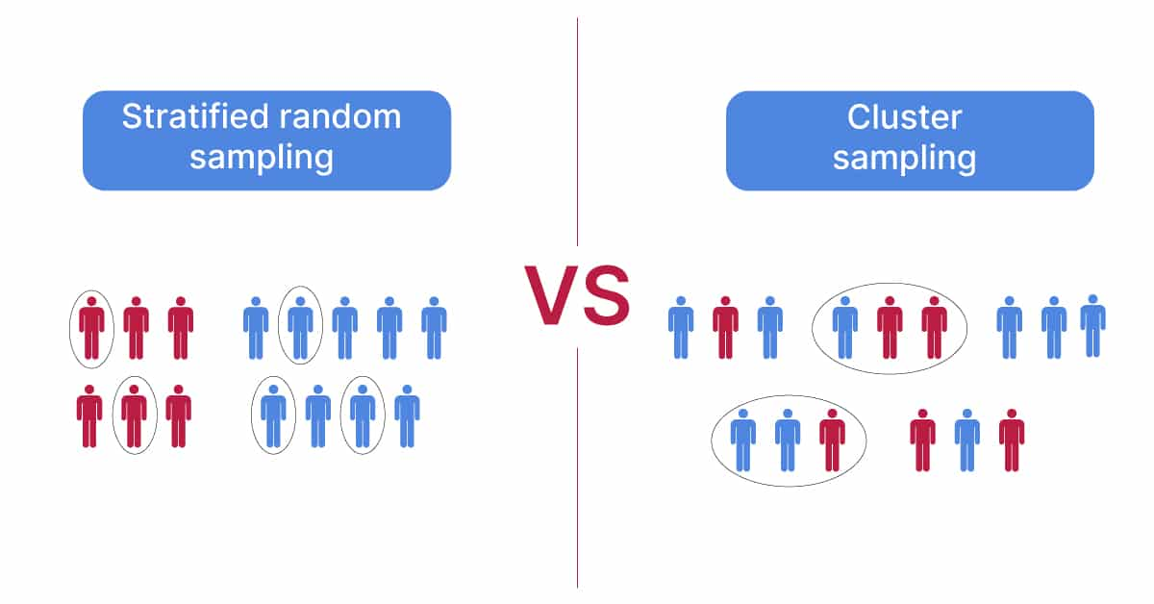
Stratified vs Cluster Sampling
Notes:
The first is known as probability sampling, the second as non-probability.
Probability sampling, as the name suggests, is based on the idea that the people or events that are chosen as the sample because the researcher has some notion of the probability that these will be representative cross-section of the people or events in the whole population being studied. On the other hand non-probability sampling is conducted without such knowledge about whether those included in the sample are representative of the overall population.

Slide 23
SAMPLING
PROBABILITY
NON-PROBABILITY
Notes:
The first is known as probability sampling, the second as non-probability.
Probability sampling, as the name suggests, is based on the idea that the people or events that are chosen as the sample because the researcher has some notion of the probability that these will be representative cross-section of the people or events in the whole population being studied. On the other hand non-probability sampling is conducted without such knowledge about whether those included in the sample are representative of the overall population.

Slide 24
Non-probability Sampling
Subjective approach
Used when researchers are looking for
Range of conditions
Examples of dramatic variations
Used due to cost and time – probability sampling needs more planning & repeated callbacks – more expensive
Suitable for exploratory stage of research
Is done prior to probability sampling

Slide 25
Non Probability Sampling
Definition: Non-probability sampling is defined as a sampling technique in which the researcher selects samples based on the subjective judgment of the researcher rather than random selection.
It is a less stringent method. This sampling method depends heavily on the expertise of the researchers.
Not all members of the population have an equal chance of participating in the study, unlike probability sampling. Each member of the population has a known chance of being selected.
Is most useful for exploratory studies like a pilot survey (deploying a survey to a smaller sample compared to pre-determined sample size).
Researchers use this method in studies where it is impossible to draw random probability sampling due to time or cost considerations.

Slide 26
Convenience Sampling
Purposive Sampling
Non-Probability Sampling
Judgement Sampling
Quota Sampling
Snowball

Slide 27
Convenience Sampling
Researcher can choose whomever he / she wants
Informal groups of friends or relatives
Least reliable
Cheapest
Easiest to conduct

Slide 28
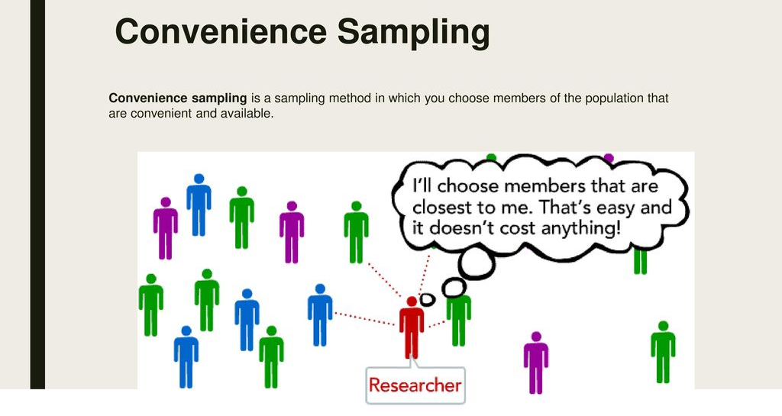
Convenience Sampling

Slide 29
Judgment Sampling
Selects sample members to conform to some criterion
Appropriate for early stages of exploratory studies
Enables the researcher to use his or her judgment to select samples
Used when working with selected small samples
Example 1: select cases that are particularly informative
TV reporters stopping certain individuals on the street in order to ask their opinions about certain political changes constitutes the most popular example of this sampling method.

Slide 30
Judgment Sampling
Strategies:
Extreme /deviant cases – can learn more
Heterogeneous / maximum variation – can document uniqueness
Homogeneous – focus on one group and in-depth
Critical case – understand what is happening in each critical case – logical generalizations can be made
Typical case – provide an illustrative profile using a representative case

Slide 31
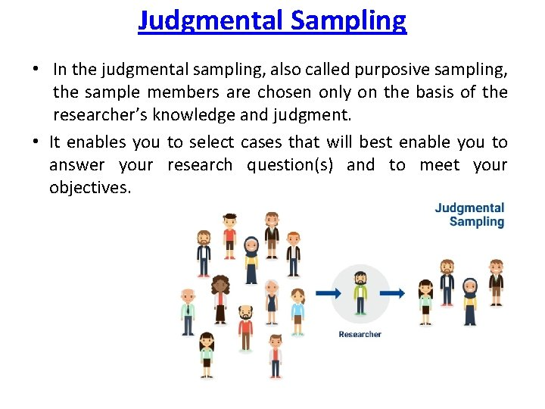
Judgment Sampling

Slide 32
Quota Sampling
Entirely non-random
Normally used for interview surveys
Normally used for large populations
How it works
Population is divided into specific groups
Quota for each group is calculated based on relevant and available data (census)
Each interviewer gets an assignment that states no of cases in each quota from which they must be collected
Data from each quota is collected & combined

Slide 33
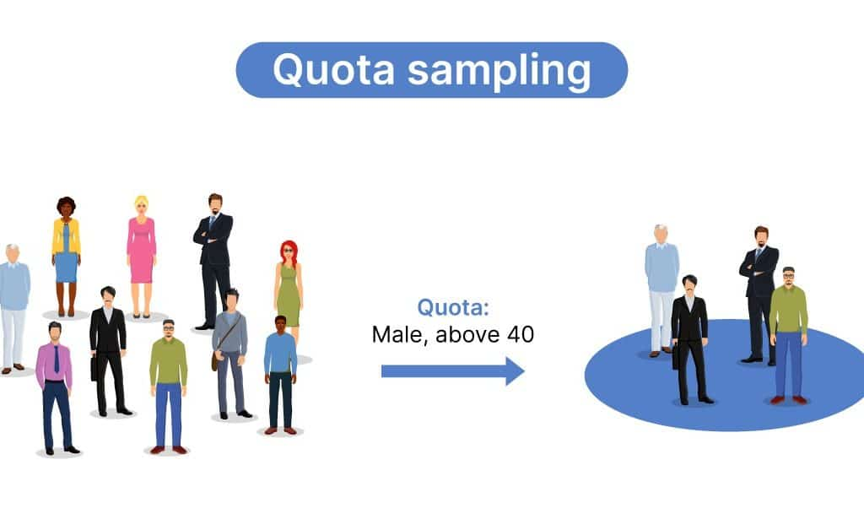
Quota Sampling

Slide 34
Snowball Sampling
Snowball sampling is an approach for locating information-rich key informants i.e. using recommendations to find people with a specific skill(s) or knowledge in a particular area.
A few potential respondents are contacted and asked whether they know of anybody with the characteristics that you are looking for in your research
Used when difficult to identify members of desired population
Respondents are best located through referral network

Slide 35
Snowball Sampling
Appropriate for qualitative studies
Similar to reverse search for bibliographic sources
Strategy:
Make contact with 1 or 2 cases in population
Ask these cases to identify others
Ask these new cases to further identify new case
Stop when no new cases / sample is large and manageable
Example:
If you are looking for a group of vegetarians or animal activists, your initial contacts should have knowledge or a member of such group which could assist you in getting more people involved with the same group.

Slide 36
Snowball Sampling
Snowball Sampling
Not a standalone tool
A method of selecting participants in a research effort leading to an interview or a survey

Slide 37
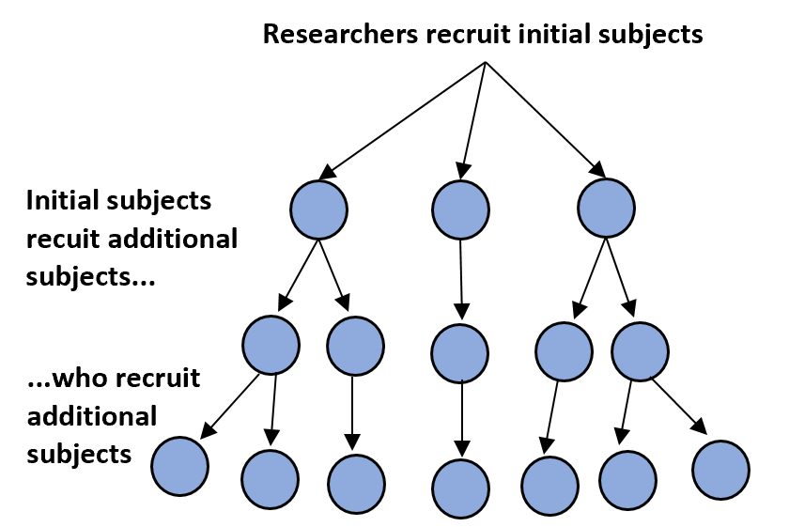
Snowball Sampling

Slide 38
Self-selection Sampling
Identify each case / individual to identify their desire to take part in the research
Strategy:
Publicize your need for cases via advertisement
Collect data from those who respond

Slide 39
Quick Review Question
Compare the various types of sampling you could use in selecting your respondents for a survey. Which would you choose and why?

Slide 40
Quick Review Question
Which method of sampling would you use when selecting the materials / books / journals to read for literature review?

Slide 41
Question and Answer Session
Q & A

